Slide 1
Basics of Web Design
Chapter 10 Form Basics Key Concepts

Slide 2
Learning Outcomes
Describe common uses of forms on web pages
Create forms on web pages using the form, input, textarea, and select elements
Associate form controls and groups using label, fieldset, and legend elements
Use CSS to style a form
Describe the features and common uses of server-side processing
Invoke server-side processing to handle form data
Configure new HTML5 form controls and attributes

Slide 3

Overview of Forms
Forms are used all over the Web to
Accept information
Provide interactivity
Types of forms:
Search form, Order form, Newsletter sign-up form, Survey form, Add to Cart form, and so on…

Slide 4
Two Components of Using Forms
1. The web page form
An HTML element that contains and organizes form controls such as text boxes, check boxes, and buttons that can accept information from website visitors.
and
2. The server-side processing
Server-side processing works with the form data and sends e-mail, writes to a text file, updates a database, or performs some other type of processing on the server.

Slide 5
HTML Using Forms
Basic Form Structure
<form action="/submit" method="post">
<!-- Form elements go here -->
<button type="submit">Submit</button>
</form>
Key Attributes:
action: URL where form data is sent
method: HTTP method (GET or POST)
enctype: Encoding type for file uploads (multipart/form-data)
Form Controls
1. Input Elements
<input type="text" name="username" placeholder="Enter username">
Common input types:
text, password, email, tel, url, number, range, date, time, datetime-local, color, file, search, checkbox, radio, submit, reset, button

Slide 6
HTML Using Forms
<form> tag
Contains the form elements on a web page
Container tag
<input> tag
Configures a variety of form elements including text boxes, radio buttons, check boxes, and buttons
Stand alone tag
<textarea> tag
Configures a scrolling text box
Container tag
<select> tag
Configures a select box (drop down list)
Container tag
<option> tag
Configures an option in the select box
Container tag

Slide 7
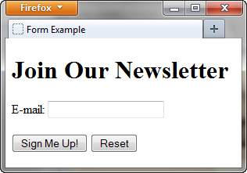
Sample Form HTML
<form>
E-mail: <input type="text" name="email" id="email" >
<br><br>
<input type="submit" value="Sign Me Up!"> <input type="reset">
</form>

Slide 8
The Form Element <form>
Container Tag
The form element attributes:
action
Specifies the server-side program or script that will process your form data
method
get – default value, form data passed in URL
post – more secure, form data passed in HTTP Entity Body
name
Identifies the form
id
Identifies the form

Slide 9
The Form Element <form>
The name and id attributes serve different purposes for an input element:
Name Attribute: The name attribute is used to identify the input field when submitting the form data to the server. It is used as a key in the key-value pair of the form data.
- When the form is submitted, the input field's value is sent to the server with the name attribute as the key.
- The name attribute is required for server-side processing of form data.
ID Attribute : The id attribute is used to uniquely identify the input element in the HTML document.
- It is used to apply styles to a specific element using CSS.
- It is used to access the element using JavaScript.
- It can also be used as an anchor for linking to a specific part of the page.
Key differences
- The name attribute is used for server-side purposes, while the id attribute is used for client-side purposes.
- The name attribute does not need to be unique, while the id attribute must be unique within the HTML document.
Here's an example:
<input type="text" id="username" name="username">
In this example, the id attribute is used to access the element using JavaScript or CSS, while the name attribute is used to identify the input field when submitting the form data to the server.

Slide 10
What is the difference between a name and Id?
When we create any Id in HTML we create variable with this name which can be accessed in javascript . For example HTML:
<form name="myCheckListForm"> <input type="text" id="checklistItem" value="just a text"> </form>
You can check it in javascript:
alert(checklistItem.value);
In this case you shouldn't enter all the statement
document.getElementById("checklistItem").value
because var checklistItem already exists !
When we use name we just add property to the object.
For example with name="checklistItem“
<form name="myCheckListForm"> <input type="text" name="checklistItem" value="just a text"> </form>
To get value of the checklistItem we have to go through all the properties begining with document. document.myCheckListForm.checklistItem.value

Slide 11

The Input Element Text Box <input>
Accepts text information
Common Attributes:
type=“text”
name
id
size
maxlength
value
required (HTML5)
placeholder (HTML5)

Slide 12

The Input Element Password Box <input>
Accepts text information that needs to be hidden as it is entered
Common Attributes:
type=“password”
name
id
size
maxlength
value
required (HTML5)
placeholder (HTML5)

Slide 13
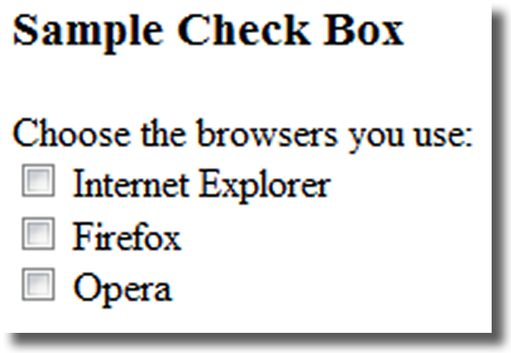
The Input Element Check box <input>
Allows the user to select one or more of a group of predetermined items
Common Attributes:
type=“checkbox”
name
id
checked
value

Slide 14
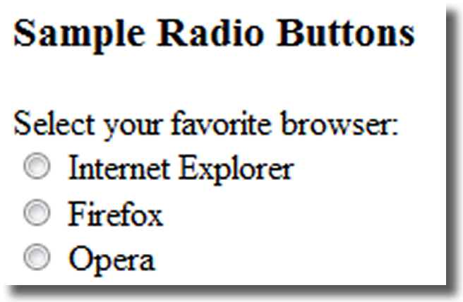
The Input Element Radio Button <input>
Allows the user to select exactly one from a group of predetermined items
Each radio button in a group is given the same name and a unique value
Comon Attributes:
type=“radio”
name
id
checked
value

Slide 15
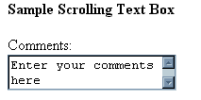
The Textarea Element <textarea>
Configures a scrolling text box
Common Attributes:
name
id
cols
rows

Slide 16

The Select Element <select>
Configures a select list (along with <option> tags)
Also known as: Select Box, Drop-Down List, Drop-Down Box, and Option Box.
Allows the user to select one or more items from a list of predetermined choices.
Common Attributes:
name
id
size
multiple

Slide 17
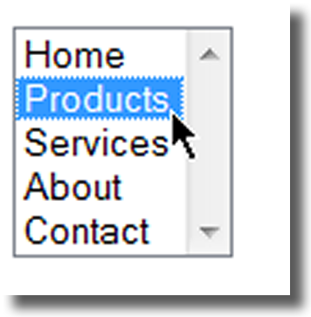
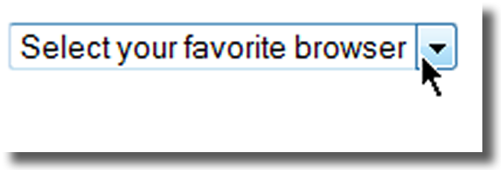
The Option Element <option>
Configures the options in a Select List
Attributes:
value
selected

Slide 18
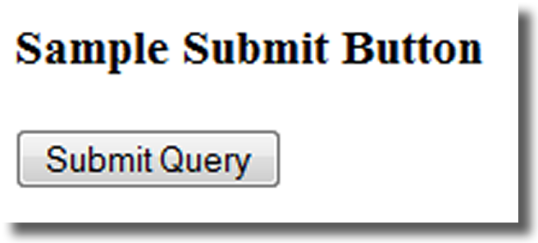
The Input Element Submit Button <input>
Submits the form information
When clicked:
Triggers the action method on the <form> tag
Sends the form data (the name=value pair for each form element) to the web server.
Attributes:
type=“submit”
name
id
value

Slide 19
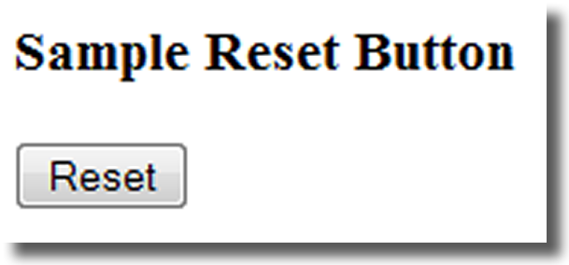
The Input Element Reset Button <input>
Resets the form fields to their initial values
Attributes:
type=“reset”
name
id
value

Slide 20
The Input Element Hidden Field <input>
This form control is not displayed on the Web page.
Hidden form fields
Can be accessed by both client-side and server-side scripting
Common Attributes:
type=“hidden”
name
id
value

Slide 21
The Label Element <label>
Associates a text label with a form control
Two Different Formats: <label>Email: <input type="text" name="CustEmail" id ="CustEmail"></label>
Or <label for="email">Email: </label> <input type="text" name="CustEmail" id= "email" />

Slide 22
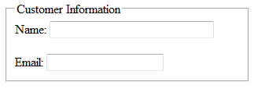
The Fieldset & Legend Elements
The Fieldset Element <fieldset>
Container tag
Creates a visual group of form controls on a web page
The Legend Element <legend>
Container tag
Creates a text label within the fieldset
<fieldset><legend>Customer Information</legend>
<label>Name: <input type="text" name="CName" id="CName" size="30"></label> <br><br >
<label>Email: <input type="text" name="CEmail" id="CEmail"></label>
</fieldset>

Slide 23
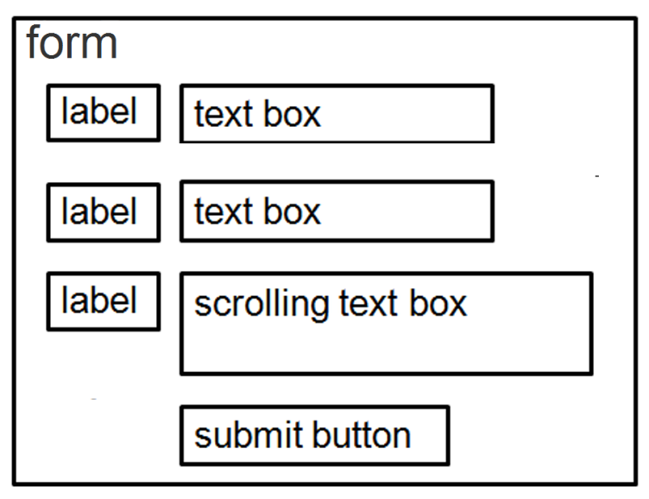
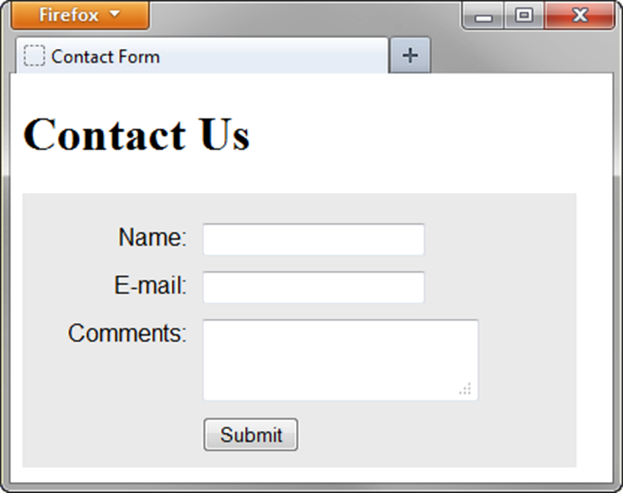
Using CSS to Style a Form
form { background-color:#eaeaea; font-family: Arial, sans-serif;
width: 350px; padding: 10px;}
label { float: left; clear: left; display: block; width: 100px;
text-align: right; padding-right: 10px; margin-top: 10px; }
input, textarea { margin-top: 10px; display: block;}
input[type= "submit"]{ margin-left: 110px; }

Slide 24
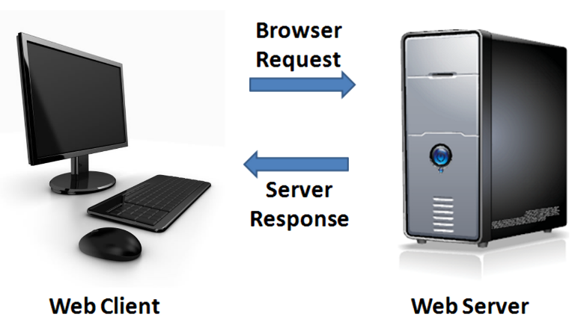
Server-Side Processing
Your web browser requests web pages and their related files from a web server.
The web server locates the files and sends them to your web browser.
The web browser then renders the returned files and displays the requested web pages for you to use.

Slide 25
Server-Side Scripting
One of many technologies in which a server-side script is embedded within a web page document saved with a file extension such as:
.php (PHP)
.cfm (Adobe ColdFusion)
.jsp (Sun JavaServer Pages)
.aspx (ASP.Net).
Uses direct execution — the script is run either by the web server itself or by an extension module to the web server.

Slide 26
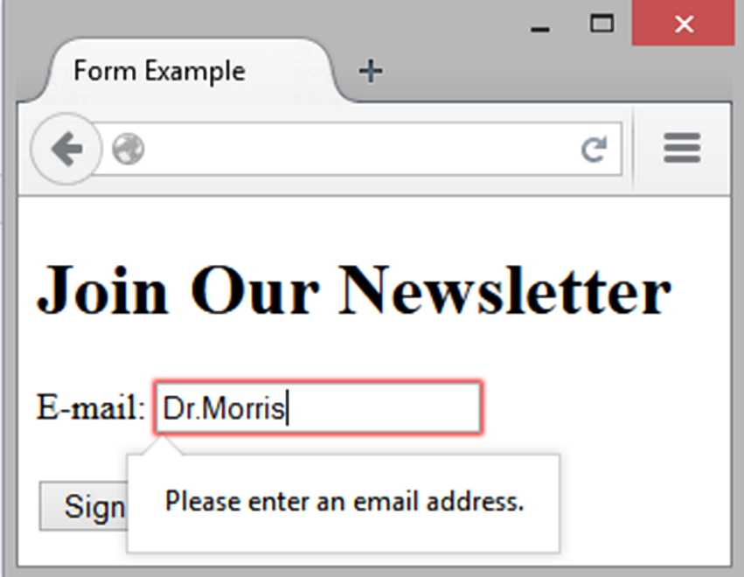
HTML5: Email Text Box <input>
Accepts text information in e-mail address format
Common Attributes:
type=“email”
name
id
size
maxlength
value
placeholder
required

Slide 27
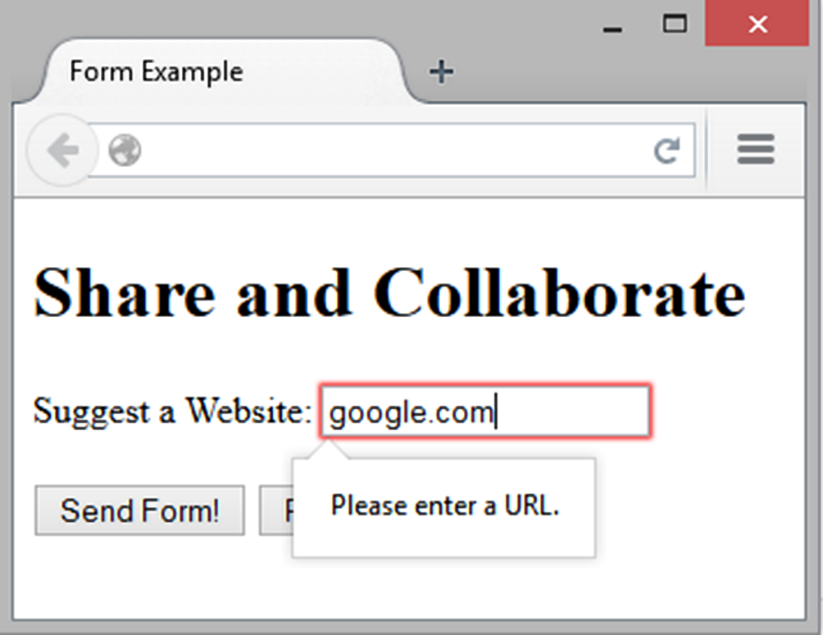
HTML5: URL Text Box <input>
Accepts text information in URL format
Common Attributes:
type=“url”
name
id
size
maxlength
value
placeholder
required

Slide 28
HTML5: Telephone Number Text Box <input>
Accepts text information in telephone number format
Common Attributes:
type=“tel”
name
id
size
maxlength
value
placeholder
required

Slide 29
HTML5: Search Text Box <input>
Accepts search terms
Common Attributes:
type=“search”
name
id
size
maxlength
value
placeholder
required

Slide 30
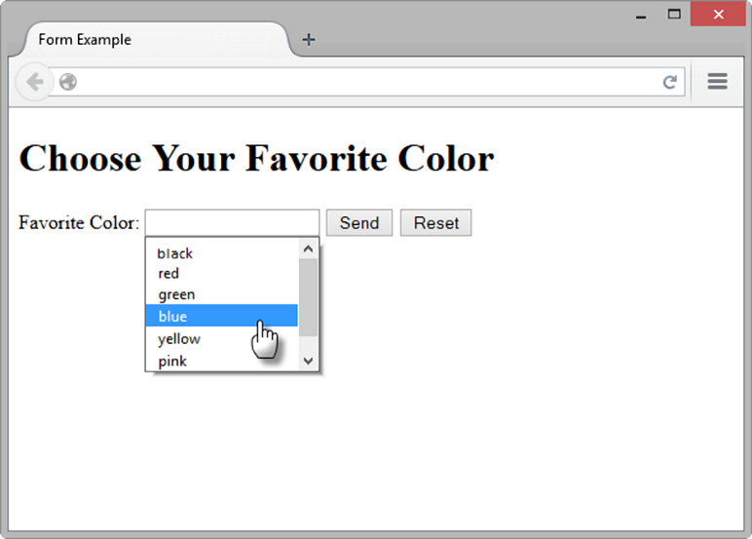
HTML5: Datalist Control
<label for="color">Favorite Color:</label> <input type="text" name="color" id="color" list="colors" >
<datalist id="colors">
<option value="red">
<option value="green">
<option value="blue">
<option value="yellow">
<option value="pink">
<option value="black">
</datalist>

Slide 31
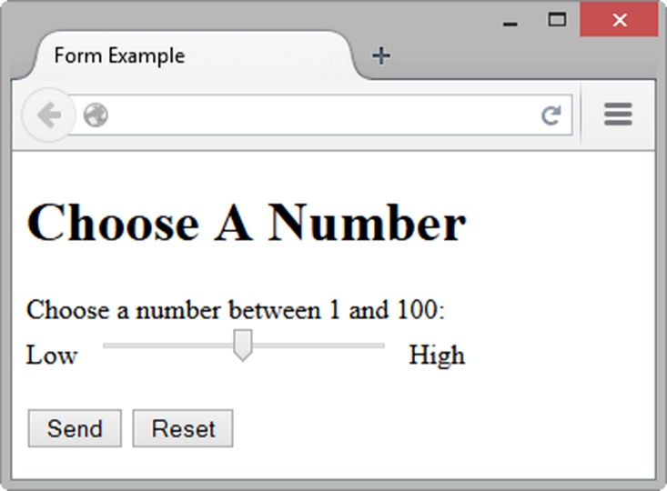
HTML5: Slider Control <input>
<label for="myChoice">
Choose a number between 1 and 100:</label><br>
Low <input type="range" name="myChoice" id="myChoice"> High

Slide 32
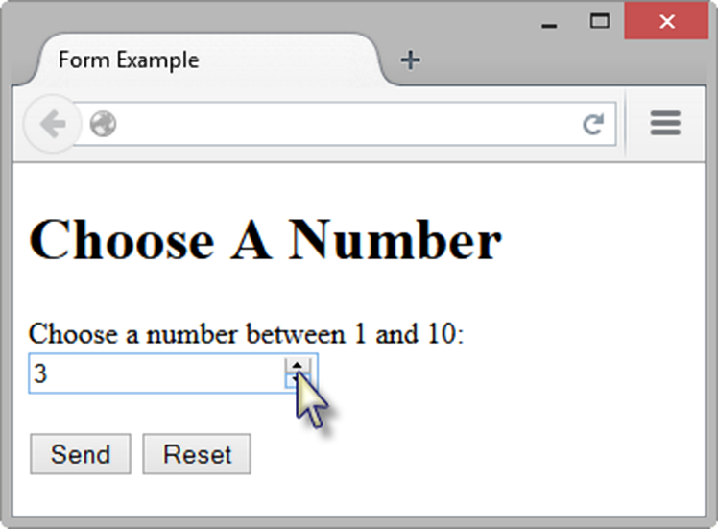
HTML5: Spinner Control <input>
<label for="myChoice">Choose a number between 1 and 10:</label> <input type="number" name="myChoice" id="myChoice"
min="1" max="10">

Slide 33
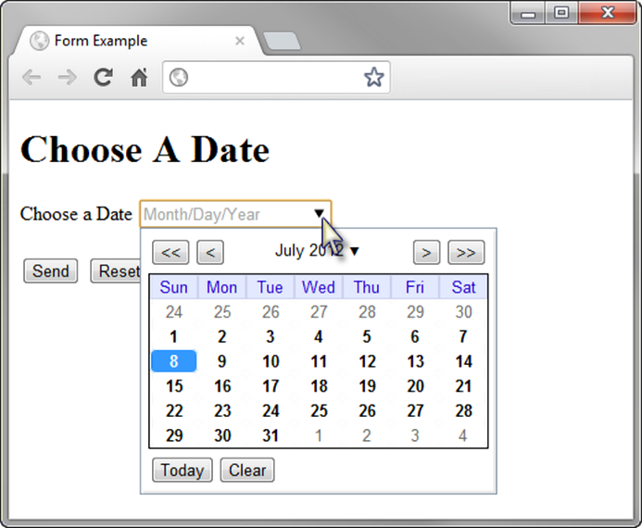
HTML5: Calendar Control <input>
<label for="myDate">Choose a Date</label> <input type="date" name="myDate" id="myDate">

Slide 34
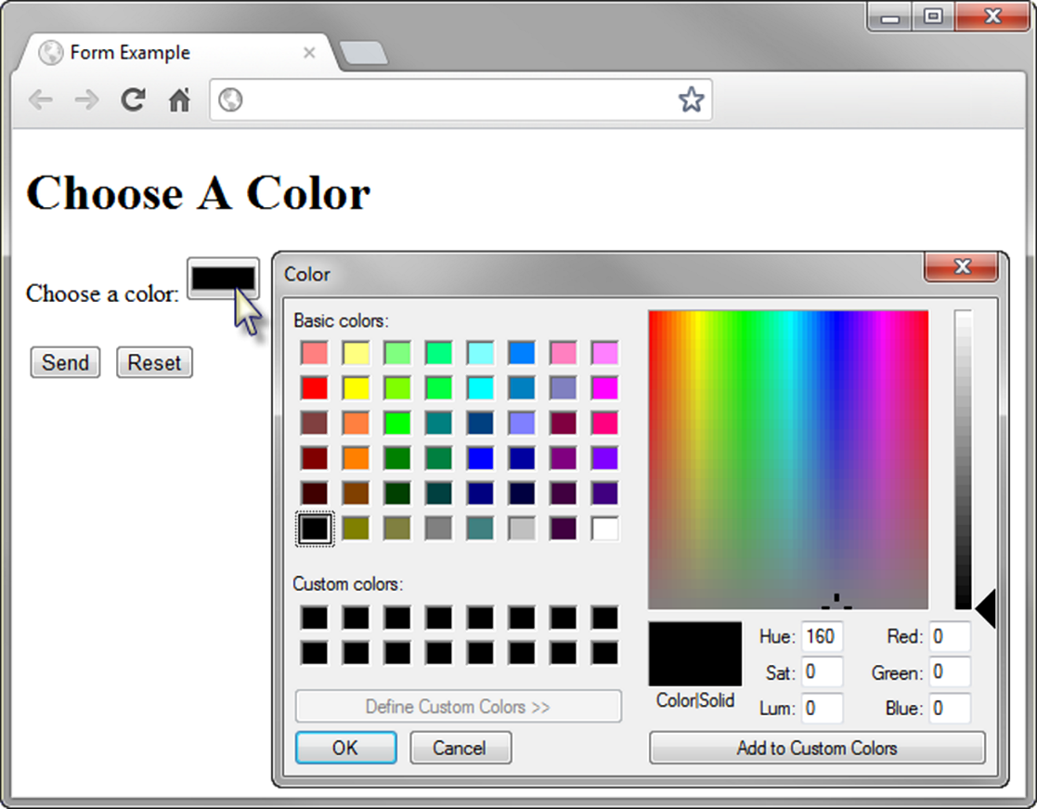
HTML5 Color-well Control
<label for="myColor">Choose a color:</label>
<input type="color" name="myColor" id="myColor">

Slide 35
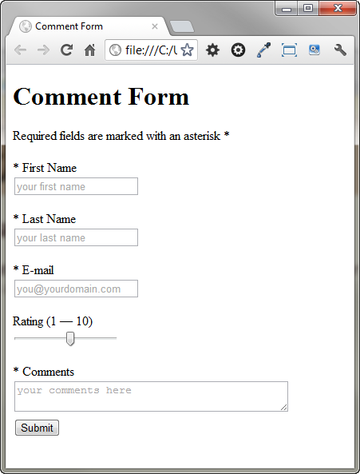
Practice with an HTML5 Form
The form display and functioning varies with browser support.

Slide 36
Summary
This chapter introduced the use of forms on web pages.
You learned about how to configure form elements and provide for accessibility.
You learned how to configure a form to access server-side processing.
You also learned about new HTML5 form controls and attributes.

